Slide 1

Parameter-Efficient Fine-Tuning (PEFT) Techniques
A Project Presentation on Advanced Model Optimization
Institute
Guided By
LD College of Engineering, Ahmedabad
Prof. Maitrik Shah
Prepared By
Course
Makadiya Deep Dineshbhai (230280152034)
Machine Learning Using Python — B.E. Semester V (AI-ML Branch)
Dholakiya Mayur Ashokbhai (230280152018)
Balar Maulik Ghanshyambhai (230280152005)
Gajera Kuldeep Vipulbhai (230280152020)

Slide 2

Abstract: The Essence of PEFT
This project explores Parameter-Efficient Fine-Tuning (PEFT) methods to address the computational demands of fine-tuning large pre-trained models (LLMs) like BERT.
What is PEFT?
Why is it Important?
Optimisation techniques to train only a small subset of parameters (typically <1%) while freezing the bulk of the pre-trained model's weights.
Reduces training time, memory consumption, and storage requirements for task-specific models, making LPMs accessible.
Project Outcome
Demonstrate that PEFT methods (LoRA, QLoRA) achieve near-full fine-tuning performance on the SST-2 dataset with significantly less resource usage.

Slide 3




The Challenge: Moving Beyond Full Fine-Tuning
Full Fine-Tuning (FFT) Limitations
High computational cost: requires significant GPU/TPU resources.
Massive storage: need to save a full copy of the model weights for every task.
Slower convergence and higher risk of catastrophic forgetting.
Introducing Core PEFT Techniques
AdapterFusion
LoRA (Low-Rank Adaptation)
QLoRA (Quantised LoRA)
Injecting small, new layers (adapters) into the pre-trained model's architecture.
Approximating weight updates using low-rank matrices; only the rank-decomposition matrices are trained.
Combining LoRA with 4-bit quantization, further reducing memory footprint and computational requirements.

Slide 4

Dataset Focus: The Stanford Sentiment Treebank (SST-2)
SST-2: Standard for Sentiment Analysis
Task: Binary sentence-level classification (Positive / Negative).
Size: 67,349 training sentences; 1,821 validation sentences.
Relevance: A common, high-quality benchmark for evaluating model transfer capabilities in NLP.
Output: Metrics focused on Test Accuracy and F1-Score.
Using SST-2 allows for direct comparison against published benchmarks for PEFT methods on common language tasks.

Slide 5




Proposed Methodology: The Training Pipeline
We employed a systematic, four-stage approach for data preparation, model adaptation, and evaluation.
Data Preprocessing
Model Setup & PEFT Integration
Tokenisation, truncation, and padding of SST-2 sentences suitable for BERT input format.
Loading BERT base, freezing core weights, and initialising PEFT modules (LoRA/QLoRA/Adapter).
Task-Specific Fine-Tuning
Evaluation & Analysis
Training only the introduced PEFT parameters using the SST-2 training set (e.g., LoRA matrices).
Evaluating performance metrics on the validation set, focusing on accuracy, time, and memory.

Slide 6
Experimental Setup: Key Configurations
Ensuring reproducibility and a fair comparison across all fine-tuning approaches.
Base Model
BERT Base (uncased, 110M parameters)
Dataset
SST-2 Sentiment Classification
Hyperparameters
Batch Size: 32; Epochs: 15
LoRA Configuration
Rank r=16; alpha=32; Targeting query and value matrices.
Hardware
NVIDIA TESLA T4(Collab)
Frameworks
Hugging Face Transformers, PyTorch, Accelerate, PEFT library.

Slide 7
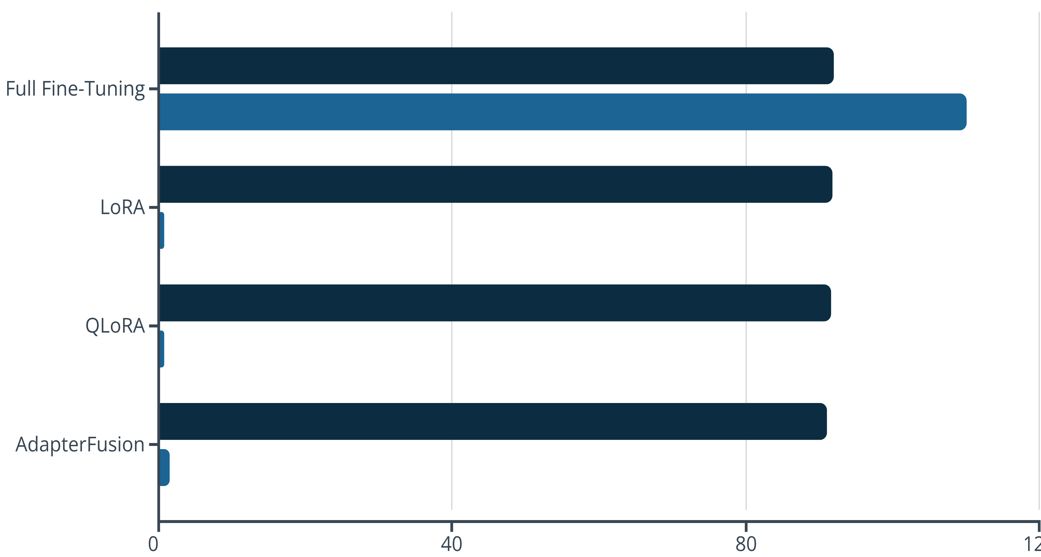






Results: Performance and Efficiency Comparison
PEFT methods maintain high accuracy while drastically reducing the number of trainable parameters.
Accuracy (%)
Trainable Parameters (M)
Accuracy
Memory Footprint
Training Speed
LoRA and QLoRA achieve 99% of FFT accuracy.
QLoRA reduces VRAM requirement by approximately 60% compared to FFT.
PEFT methods result in 2x faster overall training iterations.

Slide 8
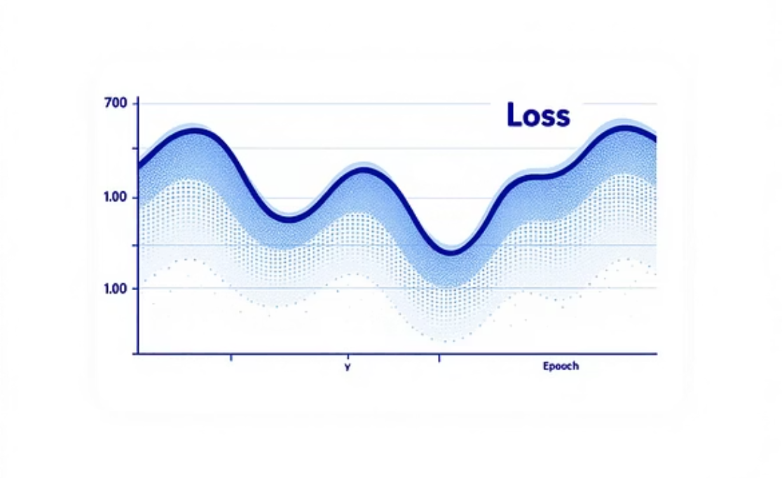
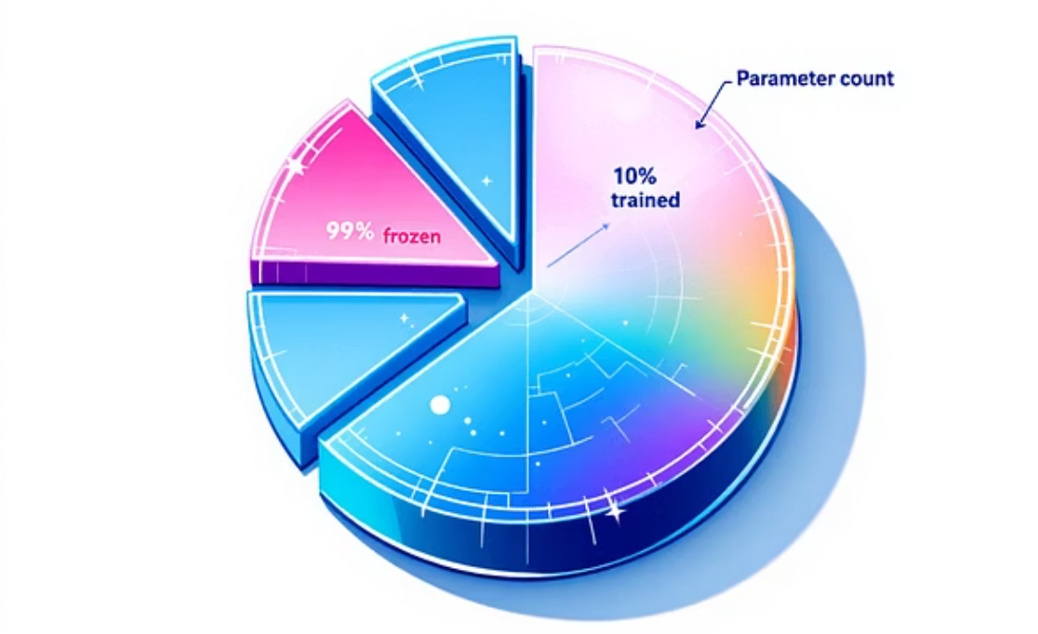

Visual Analysis: Understanding Model Training
Charts provide deeper insight into convergence and final performance characteristics.
The Loss vs Epoch plot confirms rapid convergence for PEFT methods, while the parameter comparison visualises the immense efficiency gain.

Slide 9





Conclusion and Future Directions
Efficiency Proven
Scalability Enabled
LoRA and QLoRA successfully fine-tune BERT for SST-2 with minimal parameter overhead (less than 1%) while preserving high accuracy.
These techniques democratise access to very large models by reducing the barrier of entry for resource-constrained environments.
Future Scope
Extend the work to larger and more complex models (e.g., Llama 2, GPT-3) and evaluate newer PEFT techniques like Prefix Tuning and Prompt Tuning.
References
Hu et al. (2021). LoRA: Low-Rank Adaptation of Large Language Models.
Dodge et al. (2020). Fine-Tuning Pre-Trained Language Models: Weighting the Details.
OpenAI (2018). Improving Language Understanding by Generative Pre-Training.

